Slide 1

PROCESS MINING VIRTUAL INTERNSHIP
by
Bhavya D
Roll No : 214G1A3208
Department of Computer Science and Engineering (Data Science)
Srinivasa Ramanujan Institute of Technology
(Affiliated to JNTUA & Approved by AICTE) (Accredited by NAAC with ‘A’ Grade & Accredited by NBA (EEE, ECE & CSE)
Rotarypuram Village, B K Samudram Mandal, Ananthapuramu – 515701.
2023 - 2024

Slide 2

Contents
Course Objective
Introduction
Technology
Modules
Real Time applications
Learning outcomes
GitHub Link
Conclusion

Slide 3
Objectives of Process Mining
Process Discovery : This involves extracting process models from event logs, providing a visual representation of how processes are actually executed.
Performance Analysis : Process Mining allows for the measurements and analysis of key performance indicators(KPIs) related to process efficiency, cycle times, throughput and resource utilization. This helps in identifying areas for improvement and optimizing process performance.

Slide 4
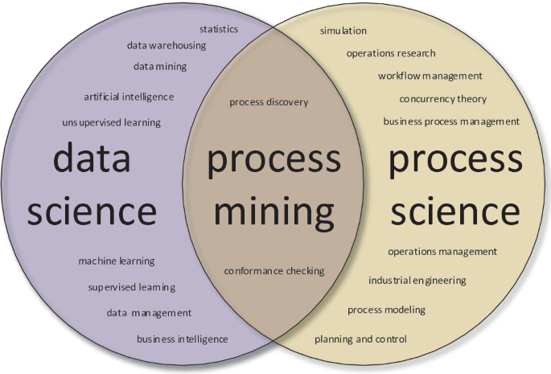
Introduction
Process mining sits at the intersection of business process management (BPM) and data mining. While process mining and data mining both work with data, the scope of each dataset differs. Process mining specifically uses event log data to generate process models which can be used to discover, compare, or enhance a given proces.
This technology quickly and realiably extracts information from event & trasaction logs to visually depict real time process models for cureent processes.

Slide 5
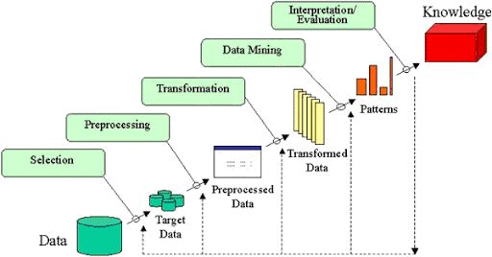
Technology of Process Mining
Data collection
Collect data from event logs, databases and other sources.
Data pre-processing
Clean, filter, and enrich data for analysis.
Process Discovery
Visualize and model process flows from event logs.
Conformance Checking
Compare modeled preprocess to actual process to identify deviations and bottlenecks.

Slide 6
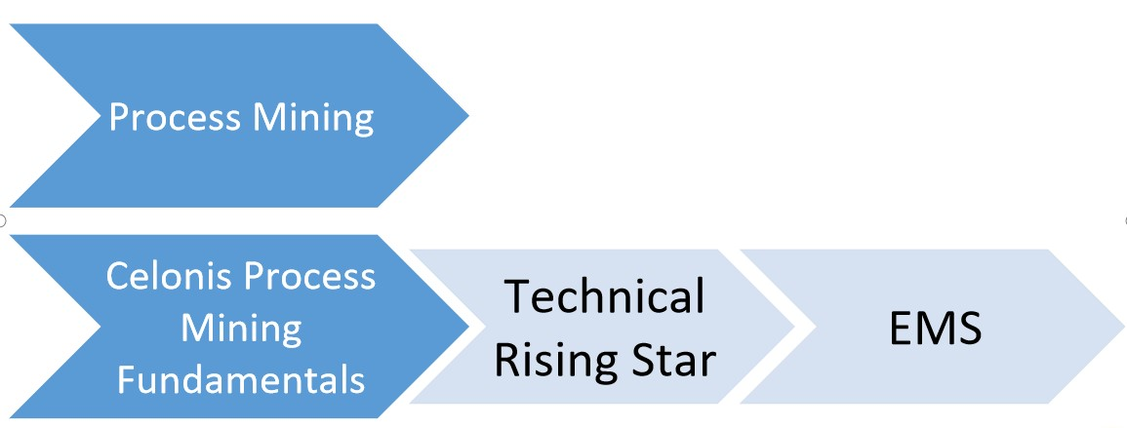
Modules

Slide 7
Process Mining Fundamentals
This module contains a good selection of academic reading, software training and application examples of where the software is used in real life. It is also accomplished by quizzes and exercises to test our knowledge and skills get by this module.
In this every chapter is explained deeply by using more real time examples by which the students can undrerstand the the chapter completely.
By this module we can completly get the theoritical knowledge we understand the module completly.

Slide 8
Technical Rising Star
The earner is able to understand both the theoretical and applied foundations around Process Mining, perform high level tasks with Celonis Analyses, write PQL queries, build and refine a Data Pipeline and Process Data Model.
Process Query Language.
PQL is the important component in process mining.
It is different from the SQL. It is designed based on requirements .If we give a question to it, it processes the data and gives the meaningful answer.
Design goals and the history of the PQL:
1.Simplicity:Easy to use and translates the complete process questions into data queries.
2.Flexibility:Formulates any question, regardless of the process.
3.Event log centered: supports process mining functionalities.
4.Business Focus : Combine process Mining and business intelligence capabilities.
5.Frontend interaction: Support of a graphical user interface(GUI).
PQL are executed in visual and code editors.

Slide 9
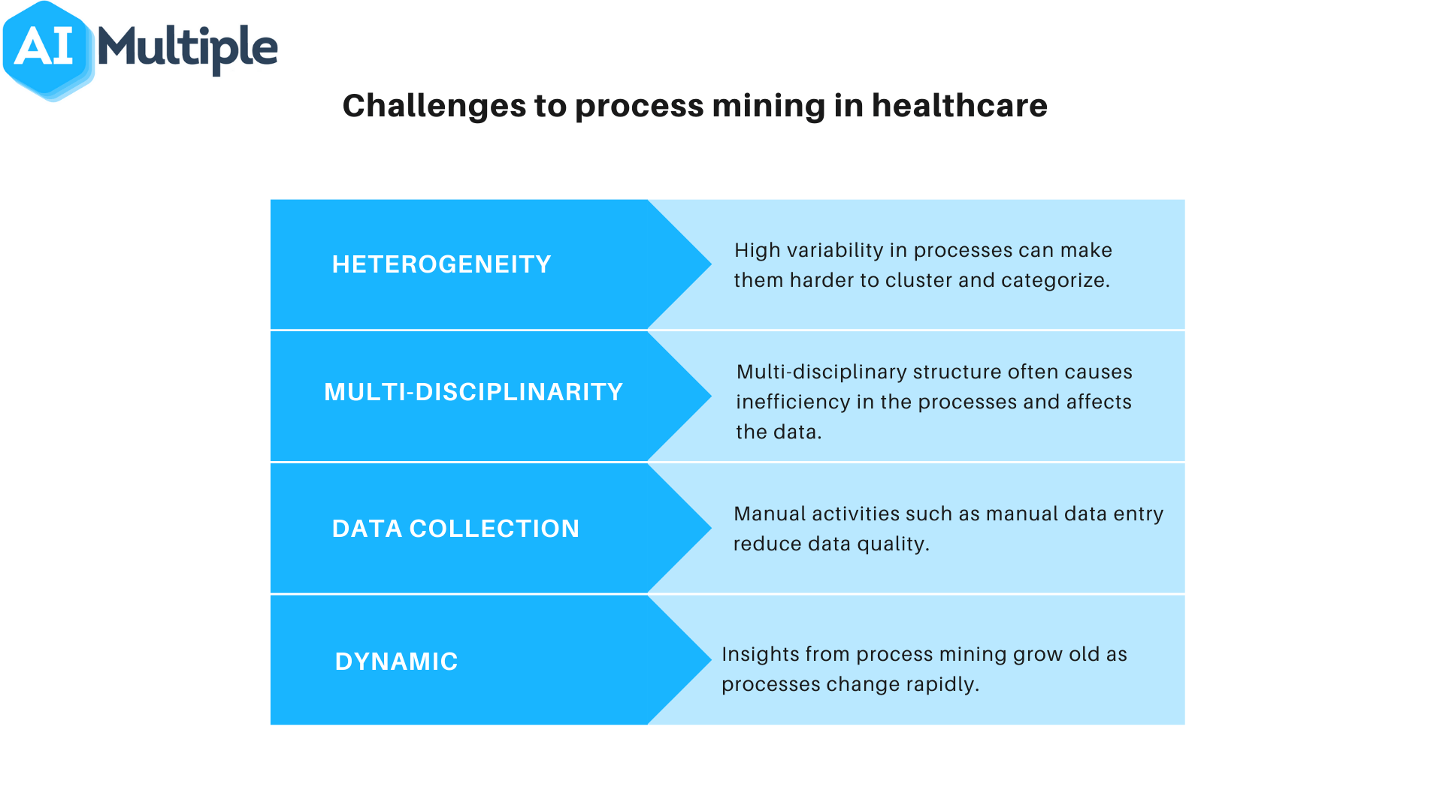
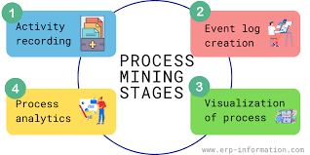

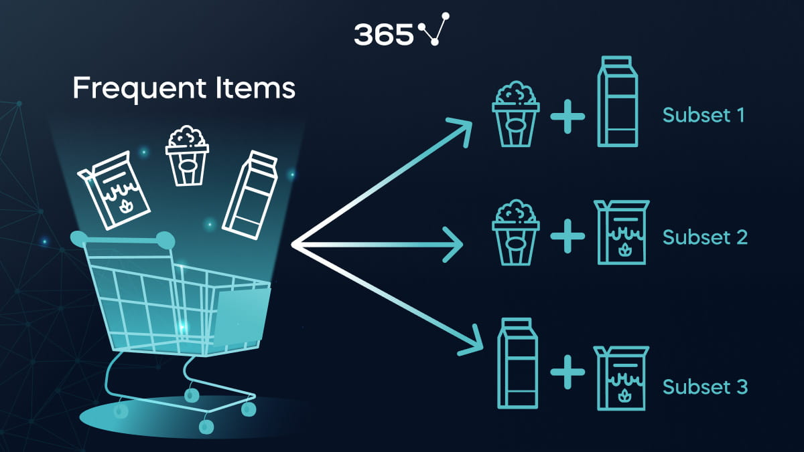
Real Time Applications
Healthcare
Improve patient care and optimize hospital processes.
Finance
Optimize financial processes,reduce froud and improve customer experience.
Customer survice
Reduce response times,improve service quality and increase customer satisfaction.
Market Basket Analysis
By predicting customers purchase behaviours, It helps to uncover patterns and relationships between products or items that are frequently purchased together.

Slide 10
Learning Outcomes
This Internships allow us to gain experience prior to searching for full-time employment.
Put our theoritical knowledge of process mining into practice.
To examine the types of the data to be mined and present a general classification of tasks and primitives to integrate a data mining system.
To helps to work with the data and process it to apply on real world applications to make application feasible and to improve the soft skills of learners.

Slide 11
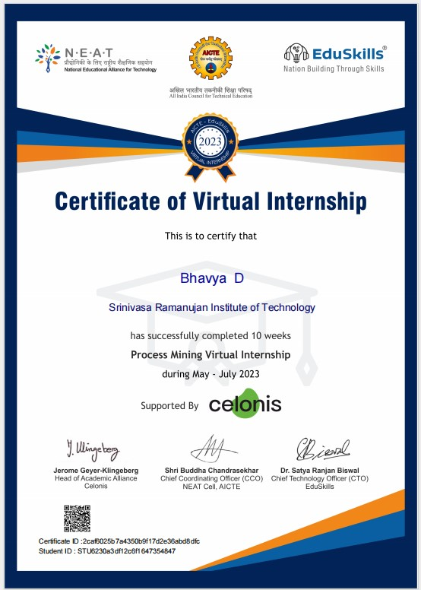
Certificate

Slide 12
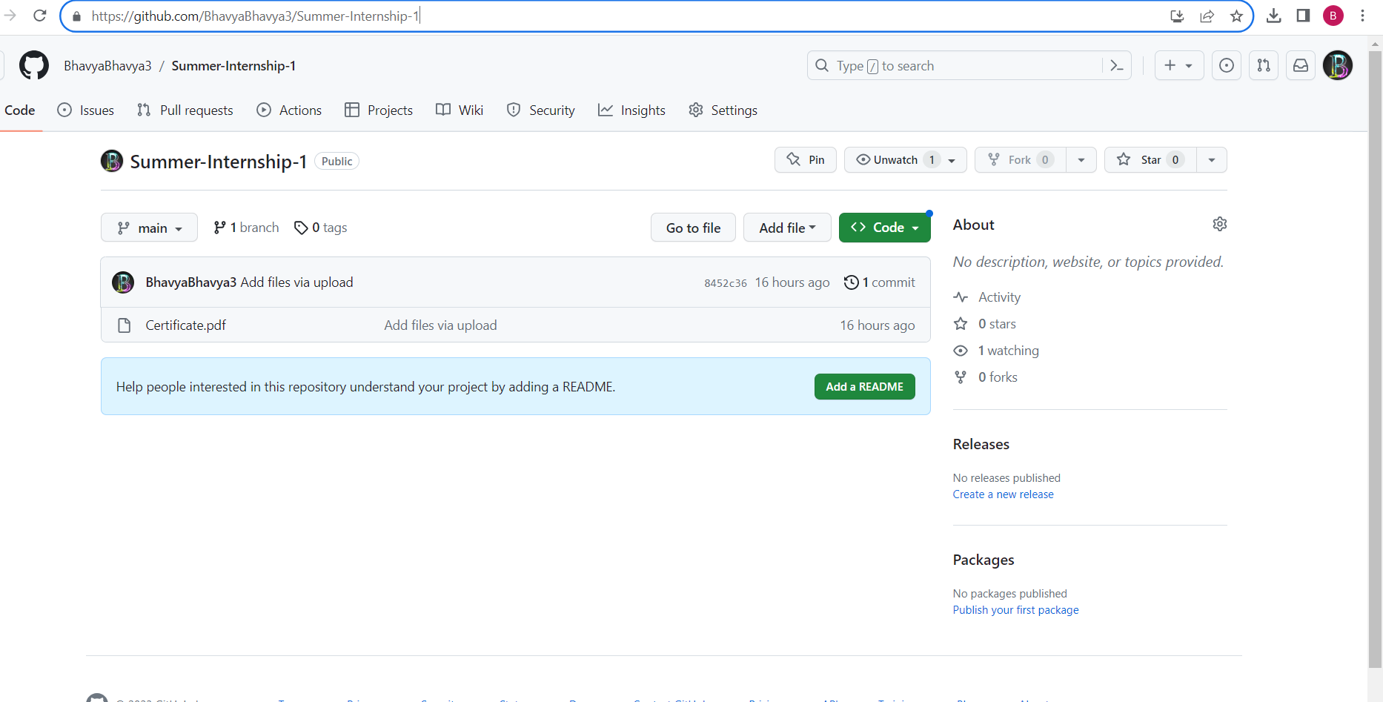

Git Hub Dashboard
Link : https://github.com/BhavyaBhavya3/Summer-Internship-1

Slide 13
Conclusion
Process mining is a powerful tool that can help organizations to identify , optimize processes, reduce costs and increase efficiency. It requires careful implementation to overcome challenges and realize its potential..
By this I learnt about the event log and also how to increase the service cost, how to process the data.
Learnt about PQL queries.

Slide 14
References:
https://core.ac.uk/download/pdf/143395465.pdf
https://www.indeed.com/career-advice/career-development/process-mining

Slide 15
Thank You!!!

